Slide 1
Spring workshop
Karthikeyan Bollu Ganesh
Michael Inden
ASMIQ Academy

Slide 2
Contents
Introduction
Spring Framework I
Spring Architecture
Dependency Injection (DI)
DI/IoC in Spring
XML Configuration
Java Configuration
Annotation Configuration
STS Suite / Plugin + Live Demo

Slide 3
Contents
Spring Framework II
Spring Boot I
Introduction
Spring Initializr
REST Service with Spring-Boot
Spring Dev-tools Demo
Testing
Bean Scopes
Bean lifecycle callbacks
Laziness
Circular dependencies
Spring Framework III
Web-MVC

Slide 4
Introduction

Slide 5

Father of Spring

Slide 6

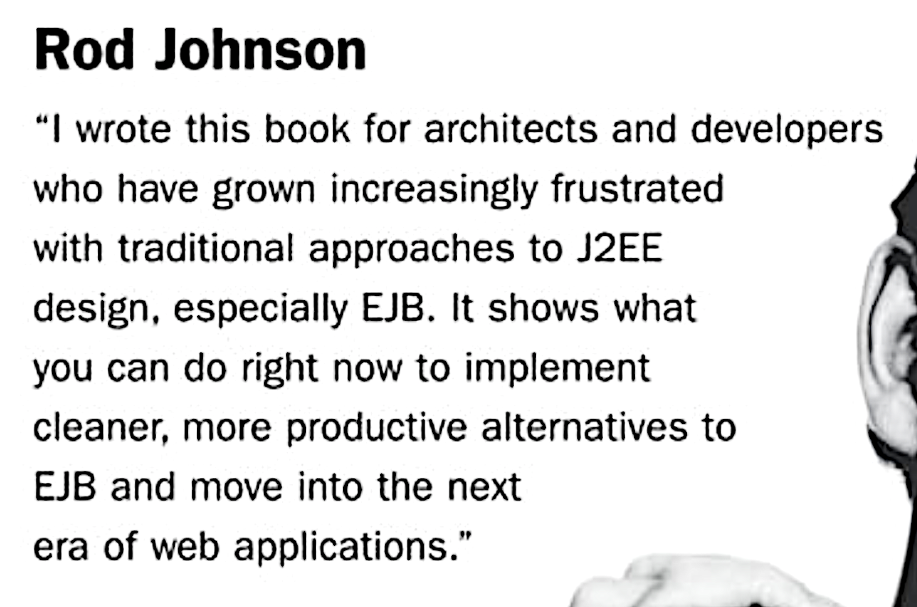
Spring‘s birth

Slide 7




Spring‘s birth
V 0.9
2002
Notes:
Rod Johnson wrote this book on 2002 with describes the complexities of the EJB and he wrote all the infrastructure code for the dependency injection in the package com.interface21. Later Jürgen Höller requested him to create a open source framework based on this infrastructure code, which gave birth to the Spring framework.

Slide 8




Spring‘s growth
4.0
5.0
2.0
3.0
1.0
Version
2003
2006
2009
2013
2017

Slide 9




Spring company‘s growth
2002
2008
2009
2013
Notes:
In April 2013 VMware, and its parent company EMC Corporation, formally created a joint venture (with GE) called Pivotal Software.

Slide 10
Spring - Benefits
Light weight
Just POJO – need not implement/extend any framework interfaces/classes
Modular
Include just the needed module to use the needed functionality.
For DI just include spring-context
Non-intrusive
domain logic code generally has no dependencies on the framework itself
Notes:
Light weight/ Non-intrusive: POJO means Plain Old Java Object. It refers to a Java object (instance of definition) that isn't bogged down by framework extensions. -> https://spring.io/understanding/POJO
Modular: We do not all of the spring‘s modules to create an app. Forexample to use the DI functionality in our web-app, we can just add the spring-context module.

Slide 11

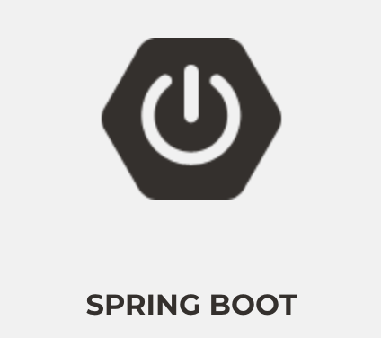


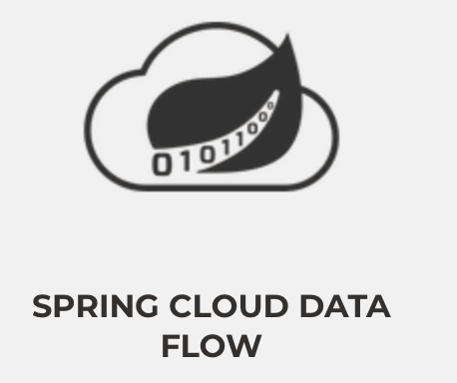
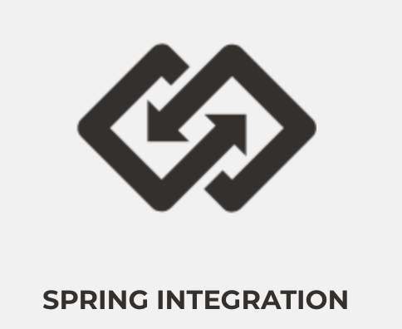


Major Spring Projects
Notes:
Change the Picture sizes
framework, boot, data, batch, cloud, cloud data flow, integration, security.

Slide 12


Spring Framework - JDK Baseline
Version | JDK 6 | JDK 7 | JDK 8 | JDK 9 | JDK 10 | JDK 11 | JDK 12
4.3.x
5.0.x
5.1.x
Notes:
JDK6 and JDK7 - Grey
JDK 8 LTS , JDK 11 LTS - Blue colour

Slide 13
Spring Framework 5 + JDK 9 Module
Does Spring Framework 5 work with the new Java 9 module system?
Yes, Spring Framework 5 ships with automatic module name entries in the manifests of our Spring Framework 5 jars. The public API surface of the Spring libraries remains unchanged.

Slide 14
Spring Framework I

Slide 15
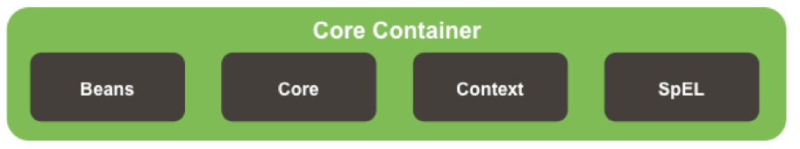
Spring Architecture

Slide 16
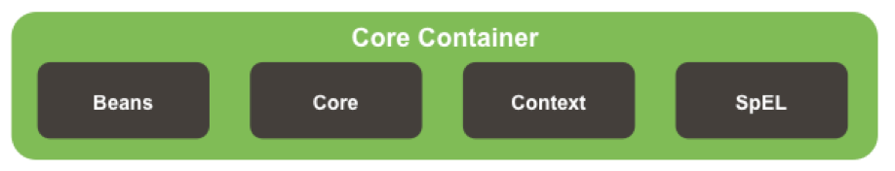
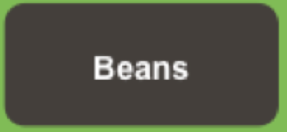


Spring Core Container Details

Slide 17
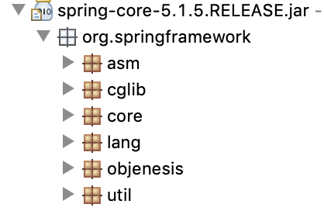
Core Module
Notes:
ASM – bytecode Manipulation and Analysis Framework
Cglib – bytecode generation library
Core – contains classes for exception-handling and for detecting the versions etc.
Lang – classes to mark the version info
Util – classes for logging configs, string manipulations etc.

Slide 18
Beans Module
Contains necessary classes and interfaces for the manipulation of the java beans
Defines most important interface like BeanFactory for Dependency Injection.
Includes utility functions for checking property types, copying bean properties, instantiating java beans.

Slide 19
Context and SpEL Modules
Context
Defines the interface ApplicationContext, which extends BeanFactory
Spring Expression Language
“Language to query and manipulate the object graph at runtime.“
#{object.property}
#{object.subobject.property}

Slide 20
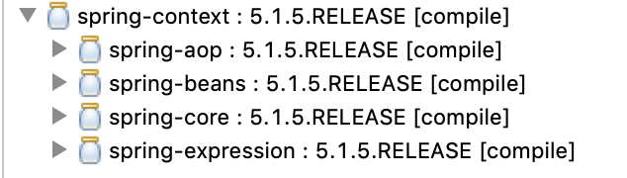
Core Container Module

Slide 21
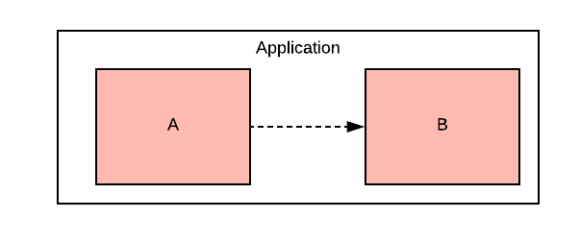
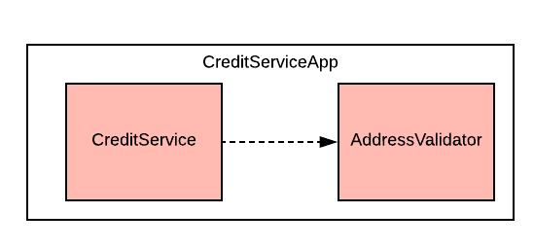
Dependency
Notes:
To provide the creditservice functionality the app depends on the validation of the address.
In crude form:
When an object A needs/uses another object B to provide a functionality of an application, then Object A is dependent on Object B

Slide 22
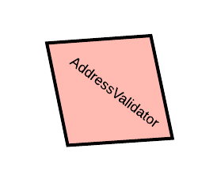
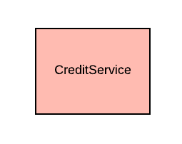


Slide 23
Dependency Injection
The process of introducing the dependency to the dependent object is called dependency injection

Slide 24
Dependency Injection
public class CreditServiceApp {
public static void main(String[] args) {
var addressValidator = new AddressValidator();
var creditService = new CreditService(addressValidator);
creditService.dispatchCredit();
}
}

Slide 25

Manual Dependency Injection
public class CreditServiceApp {
public static void main(String[] args) {
var addressValidator = new AddressValidator();
var creditService = new CreditService(addressValidator);
creditService.dispatchCredit();
}
}
Manual DI

Slide 26
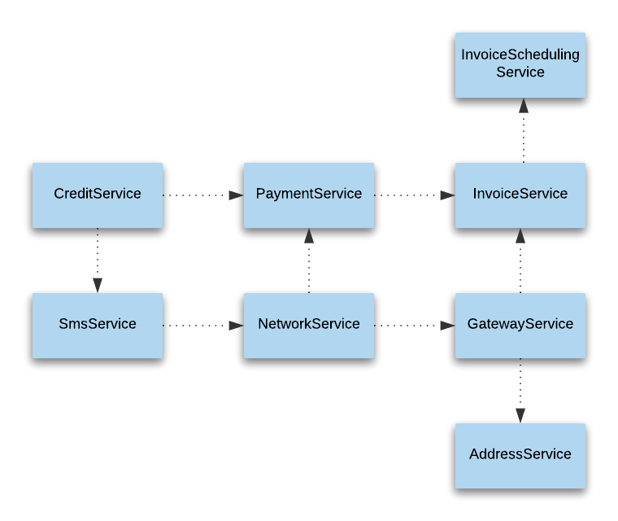

What if ?

Slide 27
Manual DI Problems
A depender knows the internal details of the dependee
Not easily testable
Tight Coupling
Hinders the code readability
Lot of manual object instantiation & boiler-plate codes
Notes:
The more the dependencies, the more the modifications in code
A depender knows the internal details of the dependee
Example - SmsService -> MobileSubscriptionService
In this case -> SmsService has to know how to create MobileSubscriptionService
Not easily testable
Without resolving all the dependencies it is almost impossible to test the NotificationService.
Tight Coupling
Changes in the construction logic of the dependee results in the changes in the construction of the depender.
Hinders the code readability
The instantiation logic are scattered, which prevents the smooth flow of understanding the actual functionality

Slide 28

Solution for manual DI Problems
having an agent/factory/framework
to instantiate the dependee objects
resolve the dependencies

Slide 29
IoC / DI
The process
of letting out our control in the instantiation of dependent objects and configuring the object graph is Inversion of Control (IoC)
of resolving the dependencies is called Dependency Injection (DI)

Slide 30

Dependency Injection in Spring

Slide 31



Spring Bean
Plain Old Java Object (POJO) which is/will be managed by the Spring is called Spring Bean.
SimpleCar Bean
Spring
SimpleCar

Slide 32
IoC Container
Is also an object
manages other objects
enables Dependecy Injection
builds Object Graphs

Slide 33
IoC Container
D
D
C
C
Spring
A
A
B
B

Slide 34
IoC configuration metadata
The information needed to configure the IoC Container is Configuration Metadata

Slide 35

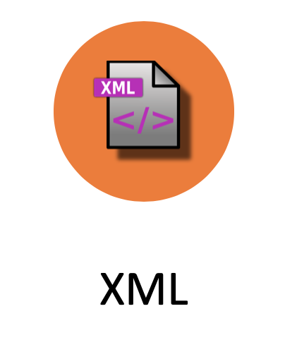

Configuration metadata types
XML
Java
Annotation

Slide 36

XML Configuration
<?xml version="1.0" encoding="UTF-8"?>
<beans xmlns="http://www.springframework.org/schema/beans"
xmlns:xsi="http://www.w3.org/2001/XMLSchema-instance"
xsi:schemaLocation="http://www.springframework.org/schema/beans http://www.springframework.org/schema/beans/spring-beans.xsd">
<bean id=“person" class=“ch.karthi.Person">
<property name=“name“ value=“karthi“ />
<property name=“age“ value=“22“ />
</bean>
</beans>

Slide 37

Java Configuration
@Configuration
public class MyConfig{
@Bean
public Person createPerson(){
Person person = new Person();
person.setName(“karthi“);
person.setAge(“22“);
return person;
}
}

Slide 38

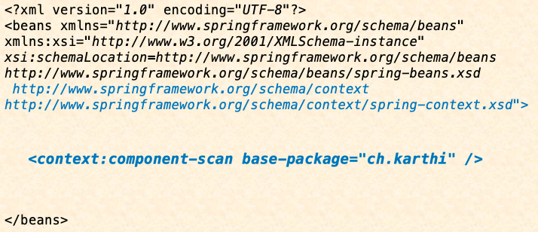

Annotation Configuration
@Component
public class Person {
...
}

Slide 39
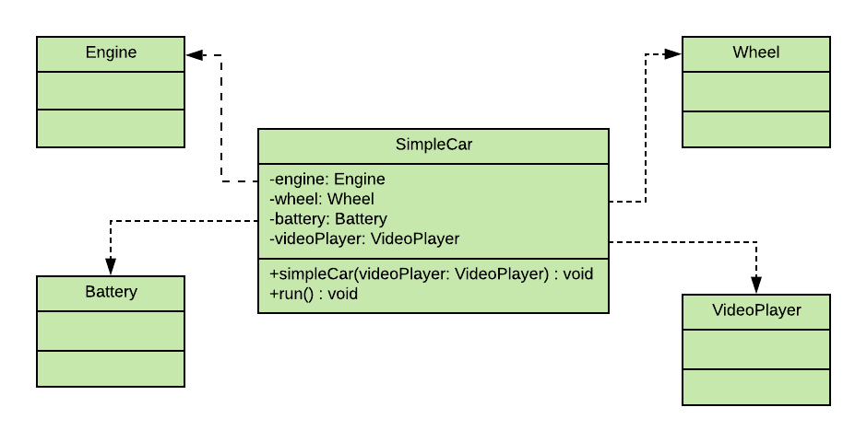
XML Configuration

Slide 40
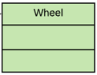
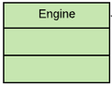
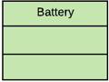
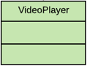
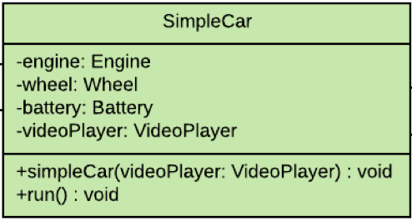
<?xml version="1.0" encoding="UTF-8"?>
<beans xmlns="http://www.springframework.org/schema/beans"
xmlns:xsi="http://www.w3.org/2001/XMLSchema-instance"
xsi:schemaLocation="http://www.springframework.org/schema/beans http://www.springframework.org/schema/beans/spring-beans.xsd">
<bean id="wheel" class="ch.karthi.Wheel"/>
<bean id="engine" class="ch.karthi.Engine"/>
<bean id="battery" class="ch.karthi.Battery"/>
<bean id="videoPlayer" class="ch.karthi.VideoPlayer"/>
<bean id="simpleCar" class="ch.karthi.SimpleCar">
<constructor-arg ref="videoPlayer" name="videoPlayer"/>
<property name="engine" ref="engine" />
<property name="wheel" ref="wheel"/>
<property name="battery" ref="battery"/>
</bean>
</beans>

Slide 41
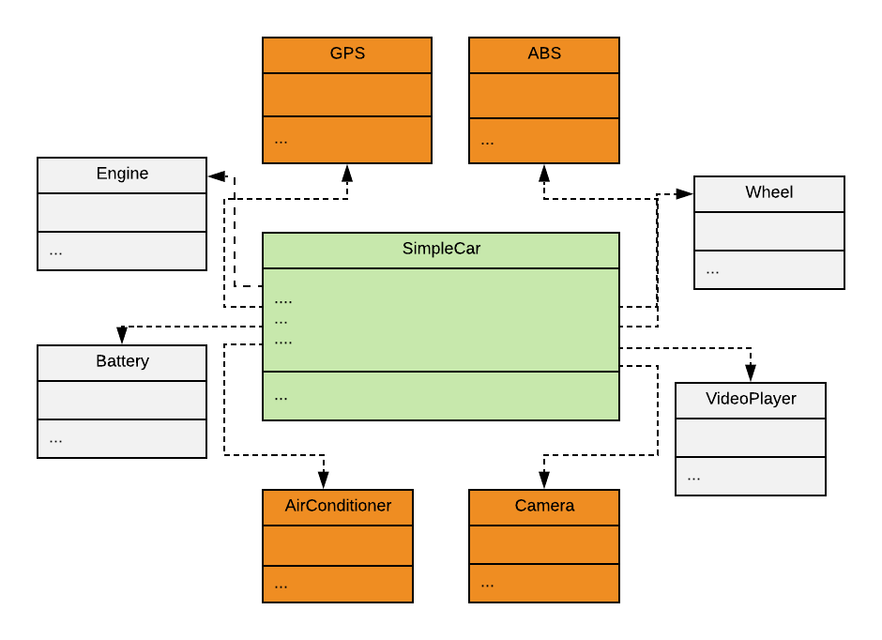
XML Configuration

Slide 42
<?xml version="1.0" encoding="UTF-8"?>
<beans xmlns="http://www.springframework.org/schema/beans"
xmlns:xsi="http://www.w3.org/2001/XMLSchema-instance"
xsi:schemaLocation="http://www.springframework.org/schema/beans http://www.springframework.org/schema/beans/spring-beans.xsd">
<bean id="wheel" class="ch.karthi.Wheel"/>
<bean id="engine" class="ch.karthi.Engine"/>
<bean id="battery" class="ch.karthi.Battery"/>
<bean id="videoPlayer" class="ch.karthi.VideoPlayer"/>
<bean id="gps" class="ch.karthi.GPS"/>
<bean id="camera" class="ch.karthi.Camera"/>
<bean id= … />
...
<bean id="simpleCar" class="ch.karthi.SimpleCar">
<constructor-arg ref="videoPlayer" name="videoPlayer"/>
<property name="engine" ref="engine" />
<property name="wheel" ref="wheel"/>
<property name="battery" ref="battery"/>
<property …..
</bean>
</beans>

Slide 43
<?xml version="1.0" encoding="UTF-8"?>
<beans …
<bean id="wheel" class="ch.karthi.Wheel"/>
<bean id="engine" class="ch.karthi.Engine"/>
<bean id="battery" class="ch.karthi.Battery"/>
<bean id="videoPlayer" class="ch.karthi.VideoPlayer"/>
<bean id="gps" class="ch.karthi.GPS"/>
<bean id="camera" class="ch.karthi.Camera"/>
<bean id= … />
...
Karthi : Hey Spring! Could you please do the bean definitions for me ?
Spring : Yes with pleasure. For that I need some infos too
<bean id="simpleCar" class="ch.karthi.SimpleCar">
…
</bean>
</beans>

Slide 44
<?xml version="1.0" encoding="UTF-8"?>
<beans xmlns="http://www.springframework.org/schema/beans"
xmlns:xsi="http://www.w3.org/2001/XMLSchema-instance"
xsi:schemaLocation=http://www.springframework.org/schema/beans http://www.springframework.org/schema/beans/spring-beans.xsd
http://www.springframework.org/schema/context http://www.springframework.org/schema/context/spring-context.xsd">
<bean id="simpleCar" class="ch.karthi.SimpleCar">
<constructor-arg ref="videoPlayer" name="videoPlayer"/>
<property name="engine" ref="engine" />
<property name="wheel" ref="wheel"/>
<property name="battery" ref="battery"/>
<property …..
</bean>
</beans>

Slide 45

Annotation configuration
@Component
public class Wheel {
Stereotype Annotations
@Component
public class SimpleCar {
@Component
public class Engine {
@Component
public class VideoPlayer {
@Component
public class Battery {

Slide 46
Stereotype Annotations
@Component
@Service
@Repository
@Controller
@RestController
@ControllerAdvice
@Configuration

Slide 47
<?xml version="1.0" encoding="UTF-8"?>
<beans xmlns="http://www.springframework.org/schema/beans"
xmlns:xsi="http://www.w3.org/2001/XMLSchema-instance"
xsi:schemaLocation=http://www.springframework.org/schema/beans http://www.springframework.org/schema/beans/spring-beans.xsd
http://www.springframework.org/schema/context http://www.springframework.org/schema/context/spring-context.xsd">
Karthi : Hey Spring! is it possible to configure these dependencies in java class itself?
Spring : Yes with pleasure. see @Autowired
<bean id="simpleCar" class="ch.karthi.SimpleCar">
<constructor-arg ref="videoPlayer" name="videoPlayer"/>
<property name="engine" ref="engine" />
<property name="wheel" ref="wheel"/>
<property name="battery" ref="battery"/>
<property …..
</bean>
</beans>

Slide 48
@Autowired
@Component
public class SimpleCar {
@Autowired
private Engine engine;
@Autowired
private Wheel wheel;
@Autowired
private Battery battery;
//this is autowired through constructor
private VideoPlayer videoPlayer;
…
@Autowired
public SimpleCar(VideoPlayer videoPlayer) {
this.videoPlayer = videoPlayer;
}

Slide 49
<?xml version="1.0" encoding="UTF-8"?>
<beans xmlns="http://www.springframework.org/schema/beans"
xmlns:xsi="http://www.w3.org/2001/XMLSchema-instance"
xsi:schemaLocation=http://www.springframework.org/schema/beans http://www.springframework.org/schema/beans/spring-beans.xsd
http://www.springframework.org/schema/context http://www.springframework.org/schema/context/spring-context.xsd">
Karthi : Hey Spring! is it possible to configure this in java class itself?
Spring : Yes with pleasure. Use @ComponentScan and remove this XML File ☺
</beans>

Slide 50
Java Configuration
@ComponentScan("ch.karthi")
public class AppConfig {…}
@Component
public class Engine {…}
<bean id="engine" class="ch.karthi.Engine"></bean>
…
<bean id="simpleCar" class="ch.karthi.SimpleCar">
<constructor-arg ref="videoPlayer" name="videoPlayer"></constructor-arg>
<property name="engine" ref="engine"></property>
…
</bean>
@Component
public class SimpleCar {
@Autowired
private Engine engine;
}

Slide 51
@Configuration
public class AppConfig {
@Bean
public Battery battery() {
return new Battery();
}
//further bean definitions
@Bean
public SimpleCar simpleCar() {
SimpleCar simpleCar = new SimpleCar(videoPlayer());
simpleCar.setBattery(battery());
// set other properties
return simpleCar;
}
}

Slide 52
Autowiring byName
@Configuration
public class AppConfig {
@Bean
public Battery battery() {
return new Battery();
}
//further bean definitions
@Bean
public SimpleCar simpleCar(Battery battery, Engine engine, Wheel wheel, VideoPlayer videoPlayer){
SimpleCar simpleCar = new SimpleCar(videoPlayer);
simpleCar.setBattery(battery);
// set other properties
return simpleCar;
}
}

Slide 53
IoC Container instantiation & usage
Spring

Slide 54
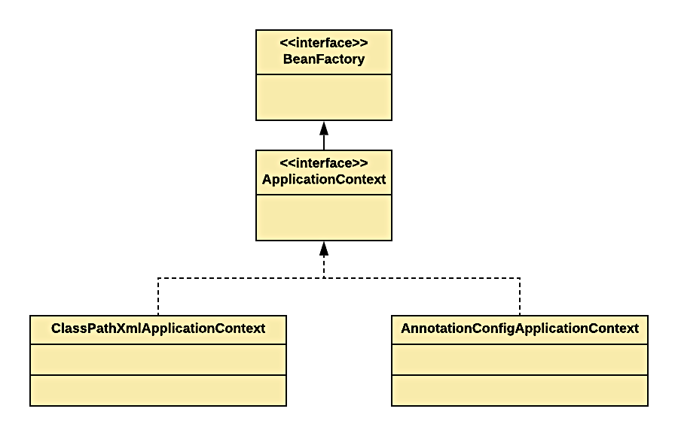
IoC Container in Spring

Slide 55
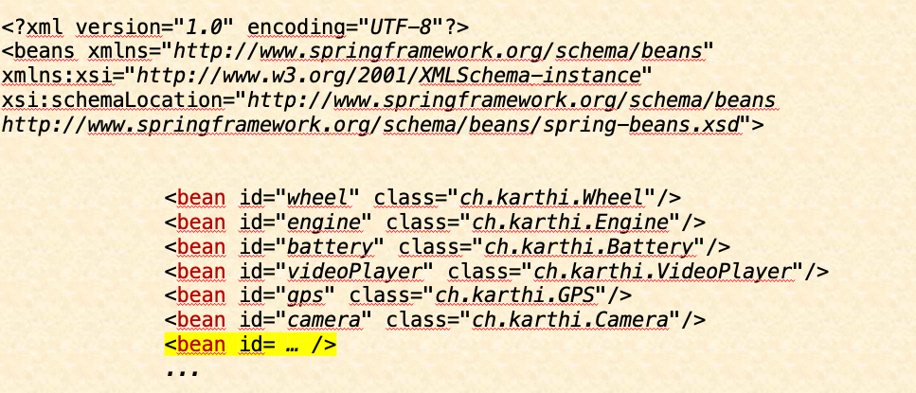
XML
var container = new ClassPathXmlApplicationContext("config.xml");
var simpleCar = container.getBean(SimpleCar.class);
// start the simpleCar

Slide 56
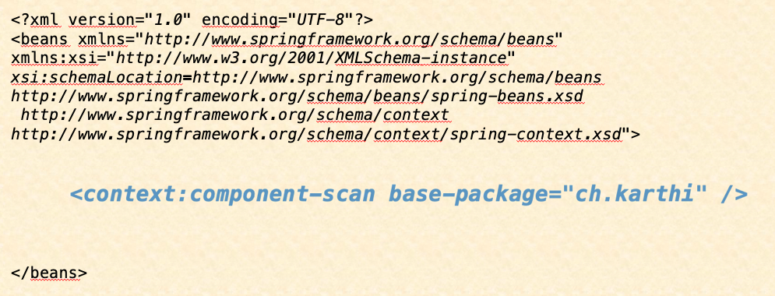
Annotation
var container = new ClassPathXmlApplicationContext("config.xml");
var simpleCar = container.getBean(SimpleCar.class);
// start the simpleCar

Slide 57

Java
@ComponentScan("ch.karthi")
public class AppConfig {…}
var container = new AnnotationConfigApplicationContext(AppConfig.class);
var simpleCar = container.getBean(SimpleCar.class);
// start the simpleCar
@Configuration
public class AppConfig {…}

Slide 58



Dependency Injection Types
Field

Slide 59
Constructor Injection
public SimpleCar(VideoPlayer videoPlayer){
this.videoPlayer = videoPlayer;
}

Slide 60
Constructor Injection
Rule: @Autowired should be present atleast on one constructor, when more than one constructor has been declared.
public SimpleCar() {}
@Autowired
public SimpleCar(VideoPlayer videoPlayer) {
this.videoPlayer = videoPlayer;
}
Exception in thread "main" java.lang.NullPointerException

Slide 61


Constructor Injection
@Autowired
public MyBean(A a) {
@Autowired
public MyBean(A a, B b) {
@Autowired
public MyBean(A a, @Autowired(required=false) B b, …) {
Spring
A
Caused by: org.springframework.beans.factory.NoSuchBeanDefinitionException: No qualifying bean of type 'ch.karthi.B' available: expected at least 1 bean which qualifies as autowire candidate. Dependency annotations: {}

Slide 62
Setter Injection
public class SimpleCar {
private Engine engine;
private Wheel wheel;
@Autowired
public void setEngine(Engine engine) {
this.engine = engine;
}
@Autowired
public void setWheel(Wheel wheel) {
this.wheel = wheel;
}
}

Slide 63
Setter Injection
public class SimpleCar {
@Autowired
private Engine engine;
@Autowired
private Wheel wheel;
}
Field Injection

Slide 64
Constructor /Setter/Field Injection ?
Use constructor for mandatory fields
Use setter for optional fields
Field injection should be mostly avoided

Slide 65
Problems with Field Injection
Final/Immutable objects not possible.
Unit testing not possible w/o reflection
Tight coupling to the DI-Framework
Heavily used field injection may be an indicator of violation of SRP.

Slide 66
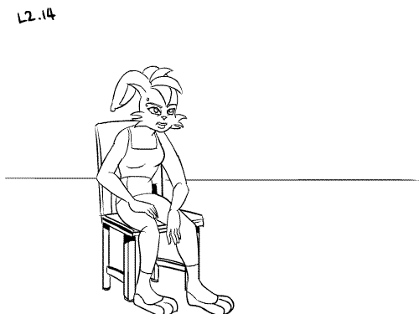


Exercises – Spring Framework I Questions 1 to 4

Slide 67
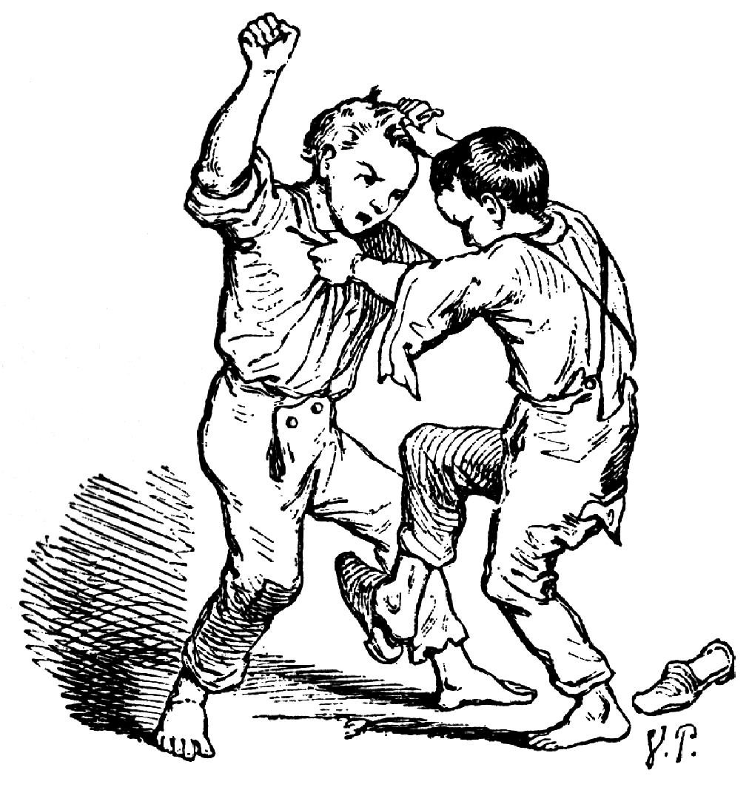
Dependency Resolution in conflicts

Slide 68
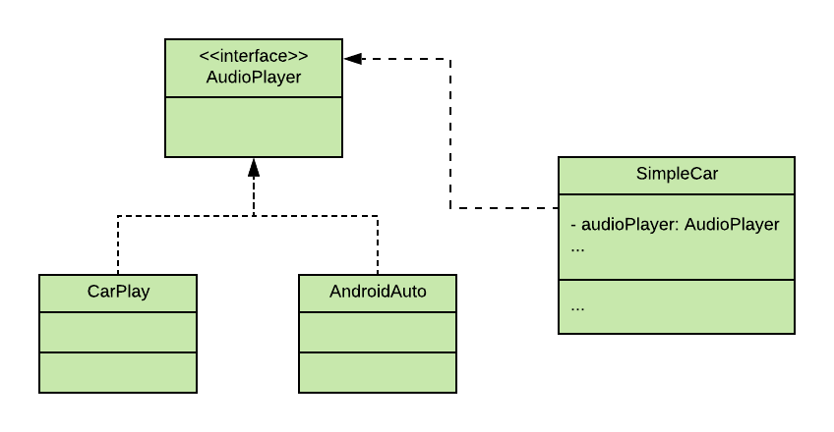
SimpleCar with AudioPlayer

Slide 69

public interface AudioPlayer {...}
@Component
public class AndroidAuto implements AudioPlayer { ... }
@Component
public class CarPlay implements AudioPlayer { ... }
@Component
public class SimpleCar {
@Autowired
private AudioPlayer audioPlayer;
}
org.springframework.beans.factory.NoUniqueBeanDefinitionException: No qualifying bean of type
'ch.karthi.AudioPlayer' available: expected single matching bean but found 2: androidAuto,carPlay

Slide 70
Dependency Resolution Modes
@Primary
@Qualifier
byName
byType

Slide 71
@Primary
public interface AudioPlayer {...}
@Primary
@Component
public class AndroidAuto implements AudioPlayer { ... }
@Primary
@Component
public class CarPlay implements AudioPlayer { ... }
@Component
public class SimpleCar {
@Autowired
private AudioPlayer audioPlayer;
}
org.springframework.beans.factory.NoUniqueBeanDefinitionException: No qualifying bean of type
'ch.karthi.AudioPlayer' available: expected single matching bean but found 2: androidAuto,carPlay

Slide 72
@Qualifier
public interface AudioPlayer {...}
@Component
public class AndroidAuto implements AudioPlayer { ... }
@Component(“carplay”)
public class CarPlay implements AudioPlayer { ... }
@Component
public class SimpleCar {
@Autowired
@Qualifier(“carplay“)
private AudioPlayer audioPlayer;
}
org.springframework.beans.factory.NoUniqueBeanDefinitionException: No qualifying bean of type
'ch.karthi.AudioPlayer' available: expected single matching bean but found 2: androidAuto,carPlay

Slide 73
byName
public interface AudioPlayer {...}
@Component
public class AndroidAuto implements AudioPlayer { ... }
@Component(“carplay”)
public class CarPlay implements AudioPlayer { ... }
@Component
public class SimpleCar {
@Autowired
private AudioPlayer carplay;
}
org.springframework.beans.factory.NoUniqueBeanDefinitionException: No qualifying bean of type
'ch.karthi.AudioPlayer' available: expected single matching bean but found 2: androidAuto,carPlay

Slide 74
byName [fallback]
public interface AudioPlayer {...}
@Component
public class AndroidAuto implements AudioPlayer { ... }
@Component
public class CarPlay implements AudioPlayer { ... }
@Component
public class SimpleCar {
@Autowired
private AudioPlayer carPlay;
}
org.springframework.beans.factory.NoUniqueBeanDefinitionException: No qualifying bean of type
'ch.karthi.AudioPlayer' available: expected single matching bean but found 2: androidAuto,carPlay

Slide 75
byType
public interface AudioPlayer {...}
@Component
public class AndroidAuto implements AudioPlayer { ... }
@Component
public class CarPlay implements AudioPlayer { ... }
@Component
public class SimpleCar {
@Autowired
private CarPlay audioPlayer;
}
org.springframework.beans.factory.NoUniqueBeanDefinitionException: No qualifying bean of type
'ch.karthi.AudioPlayer' available: expected single matching bean but found 2: androidAuto,carPlay

Slide 76

DI of scalar values

Slide 77
@Value
@Component
@PropertySource("car.properties")
public class Wheel {
@Value("${wheel.radius}")
private double radius = -1.0d;
...
}
@Component
public class Wheel {
private double radius = 2.34d;
...
}
src/main/resources/car.properties
wheel.radius=2.34
@Value("${wheel.radius:2.34}")
private double radius = -1.0d;

Slide 78

Tooling
Notes:
Pause hier ☺

Slide 79
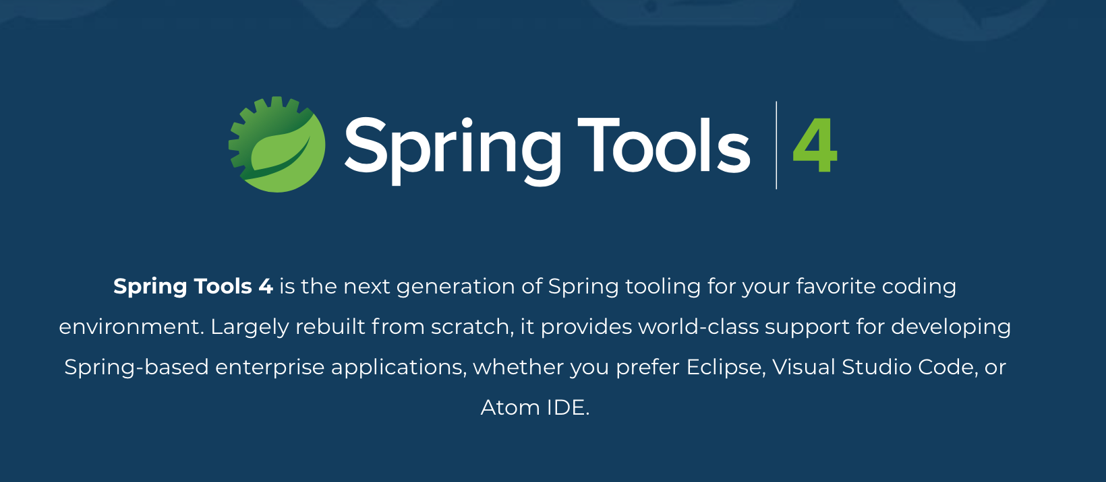
Spring Tool Suite (STS)

Slide 80
STS
Standalone
Plugin
Notes:
Standalone - https://spring.io/tools
Plugin - https://marketplace.eclipse.org/content/spring-tools-4-spring-boot-aka-spring-tool-suite-4

Slide 81
Spring Tool Suite (STS)

Slide 82
STS Demo
bean-graph

Slide 83
Exercises – Spring Framework I Questions 5 to 8
Notes:
8 zusammen als Demo

Slide 84
Spring Framework II

Slide 85

Laziness is good ☺

Slide 86
Eager initialisation – Default behaviour
by default beans are initialised at startup
is good to prevent errors in dependency configuration

Slide 87
Eagerness issues
@Component
public class AndroidAuto implements AudioPlayer {
public AndroidAuto() {
//check the internet connection (3 secs)
//google account login (2 secs)
//access for microphone and camera (4 secs)
//load the playlists (2 secs)
//cache the playlists (5 secs)
}
}
@Component
public class SimpleCar {
public void run() {
//start battery
//start engine
//start the wheel
}
public void playMusic(){
audioPlayer.playMusic();
}
@Autowired
public void setAudioPlayer(AudioPlayer pl){
this.audioPlayer = pl;
}
//setter injected battery,engine,
//wheel & audioplayer
}
var context = new AnnotationConfigApplicationContext(App.class);
SimpleCar simpleCar = context.getBean(SimpleCar.class);
simpleCar.run();
//later if user press the play button
simpleCar.playMusic();

Slide 88
Laziness
@Component
public class SimpleCar {
public void run() {
//start battery
//start engine
//start the wheel
}
public void playMusic(){
if(Objects.isNull(audioPlayer))
audioPlayer = context.getBean(AudioPlayer.class);
audioPlayer.playMusic();
}
//setter injected battery,engine,wheel
}
@Lazy
@Component
public class AndroidAuto implements AudioPlayer {
public AndroidAuto() {
//check the internet connection (3 secs)
//google account login (2 secs)
//access for microphone and camera (4 secs)
//load the playlists (10 secs)
//cache the playlists (5 secs)
}
}

Slide 89

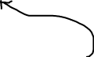

Circular Dependencies
A
B
C

Slide 90
Circular Dependency Example
@Component
public class Student {
private Department department;
@Autowired
public Student(Department department) {
...
}
}
@Component
public class Department {
private Student student;
@Autowired
public Department(Student student) {
...
}
}
Caused by: org.springframework.beans.factory.BeanCurrentlyInCreationException: Error creating bean with name 'department': Requested bean is currently in creation: Is there an unresolvable circular reference?

Slide 91
Circular dependencies solution
Modify some dependencies to be injected through setters
@Component
public class Student {
private Department department;
public Student(Department department) {
...
}
@Autowired
public void setDepartment(Department dpt){
this.department = dpt;
}
}

Slide 92
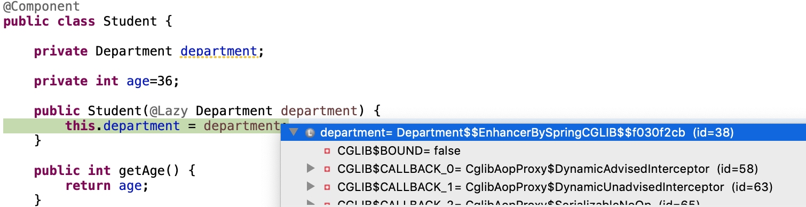
Circular dependencies solution
Lazy initialize certain dependencies
@Component
public class Student {
private Department department;
public Student(@Lazy Department department) {
...
}
}

Slide 93


Bean Scopes
Singleton
Prototype
Default

Slide 94

Singleton
getBean(A.class)
Spring
A
A
A
A

Slide 95

Singleton
Spring
getBean(A.class)
A
A

Slide 96

Prototype
In contrast to the other scopes, Spring does not manage the complete lifecycle of a prototype bean. The container instantiates, configures, and otherwise assembles a prototype object and hands it to the client, with no further record of that prototype instance.
Spring
getBean(A.class)
A
A
Notes:
In contrast to the other scopes, Spring does not manage the complete lifecycle of a prototype bean. The container instantiates, configures, and otherwise assembles a prototype object and hands it to the client, with no further record of that prototype instance.

Slide 97
Prototype
Spring
getBean(A.class)
getBean(A.class)
A
A

Slide 98
Scope Configuration
@Scope(scopeName=ConfigurableBeanFactory.SCOPE_PROTOTYPE)
@Scope(scopeName=ConfigurableBeanFactory. SCOPE_SINGLETON)
@Scope(“prototype“)
@Scope(“singleton“)

Slide 99
Scope Configuration
@Scope(“somethingwrong“)
Caused by: java.lang.IllegalStateException: No Scope registered for scope name 'somethingwrong'

Slide 100
Singleton Example
@Component
public class Shape {
private String colour="yellow";
//setter
}
@ComponentScan("ch.karthi")
public class App {
public static void main(String[] args) {
var container = //annotationcontext
var shape1 = container.getBean(Shape.class);
LOG.info(shape1);
shape1.setColour("blue");
LOG.info(shape1);
var shape2 = container.getBean(Shape.class);
LOG.info(shape2);
}
}
INFO: Shape [colour=yellow]
INFO: Shape [colour=blue]
INFO: Shape [colour=blue]

Slide 101
Prototype Example
@Scope("prototype")
@Component
public class Shape {
private String colour="yellow";
//setter
}
@ComponentScan("ch.karthi")
public class App {
public static void main(String[] args) {
var container = //annotationcontext
var shape1 = container.getBean(Shape.class);
LOG.info(shape1);
shape1.setColour("blue");
LOG.info(shape1);
var shape2 = container.getBean(Shape.class);
LOG.info(shape2);
}
}
INFO: Shape [colour=yellow]
INFO: Shape [colour=blue]
INFO: Shape [colour=yellow]

Slide 102

Singleton is per container and not per JVM
@Component
public class Shape {
// shape
}
@ComponentScan("ch.karthi")
public class App {
public static void main(String[] args) {
var container = new AnnotationConfigApplicationContext(App.class);
var container2 = new AnnotationConfigApplicationContext(App.class);
var shape1 = container.getBean(Shape.class);
LOG.info(shape1);
shape1.setColour("blue");
LOG.info(shape1);
var shape2 = container2.getBean(Shape.class);
LOG.info(shape2);
}
}
INFO: Shape [colour=yellow]
INFO: Shape [colour=blue]
INFO: Shape [colour=yellow]

Slide 103
Singleton is per container and not per classloader JVM
@Component
public class Shape {
// shape
}
@ComponentScan("ch.karthi")
public class App {
public static void main(String[] args) {
var container = new AnnotationConfigApplicationContext(App.class);
var container2 = new AnnotationConfigApplicationContext(App.class);
var shape1 = container.getBean(Shape.class);
LOG.info(shape1);
shape1.setColour("blue");
LOG.info(shape1);
var shape2 = container2.getBean(Shape.class);
LOG.info(shape2);
}
}
INFO: Shape [colour=yellow]
INFO: Shape [colour=blue]
INFO: Shape [colour=yellow]

Slide 104
other singleton pitfalls
<?xml version="1.0" encoding="UTF-8"?>
<beans xmlns="http://www.springframework.org/schema/beans"
xmlns:xsi="http://www.w3.org/2001/XMLSchema-instance"
xsi:schemaLocation="http://www.springframework.org/schema/beans
http://www.springframework.org/schema/beans/spring-beans.xsd">
<bean id="scopeTest" class="ch.karthi.Shape" scope="singleton">
<property name="colour" value="blue"/>
</bean>
<bean id="scopeTestDuplicate" class="ch.karthi.Shape" scope="singleton">
<property name="colour" value="Red"/>
</bean>
</beans>

Slide 105
other singleton pitfalls
public class App {
public static void main(String[] args) {
var ctx = new ClassPathXmlApplicationContext("shapes.xml");
Shape shape1 = (Shape)ctx.getBean("scopeTest);
Shape shape2 = (Shape) ctx.getBean("scopeTestDuplicate");
LOG.info(shape1 == shape2);
LOG.info(shape1 + "::" + shape2);
}
}
What is the output?

Slide 106
Singleton vs Prototype
Singleton => Stateless beans
Prototype => Stateful beans

Slide 107

Thread safeness
Spring beans are not thread-safe.
We have to make sure they are thread-safe by:
by not using instance variables in multithreaded environment.
OR
Use synchronized block/keyword on methods wherever the instance variables are modified

Slide 108
Bean Lifecycle Callbacks
Initialization callbacks
Destruction callbacks
Notes:
1. Initialisation Callbacks – After the bean‘s constructor has been called by Spring and we still want to do some other kind of initialisation like initialising the filestream, open up a db connection, initialising the AWS connection etc, which are not part of the bean construction but we still want to make sure these initialisation before the bean is put into use.

Slide 109
Initialization callbacks
InitializingBean
initMethod in @Bean
@PostConstruct

Slide 110
@PostConstruct
@Component
public class VideoPlayer {
private AsmiqAcademyStream asmiqAcademyStream;
private YoutubeStream youtubeStream;
private String youtubeApiKey = "y7k8nd9d92dl2m";
private String asmiqAcademyApiKey = "y7k8nd9d92dl2m";
@PostConstruct
private void initStreams() {
asmiqAcademyStream = AsmiqAcademyStream.builder().withApiKey(asmiqAcademyApiKey).build();
youtubeStream = YoutubeStream.builder().withApiKey(youtubeApiKey).build();
}
}

Slide 111
InitializingBean
@Component
public class VideoPlayer implements InitializingBean{
private AsmiqAcademyStream asmiqAcademyStream;
private YoutubeStream youtubeStream;
private String youtubeApiKey = "y7k8nd9d92dl2m";
private String asmiqAcademyApiKey = "y7k8nd9d92dl2m";
@Override
public void afterPropertiesSet() throws Exception {
initStreams();
}
private void initStreams() {
asmiqAcademyStream = AsmiqAcademyStream.builder().withApiKey(asmiqAcademyApiKey).build();
youtubeStream = YoutubeStream.builder().withApiKey(youtubeApiKey).build();
}
}

Slide 112
initMethod in @Bean
@Component
public class VideoPlayer {
private AsmiqAcademyStream asmiqAcademyStream;
private YoutubeStream youtubeStream;
private String youtubeApiKey = "y7k8nd9d92dl2m";
private String asmiqAcademyApiKey = "y7k8nd9d92dl2m“;
private void initStreams() {
asmiqAcademyStream = AsmiqAcademyStream.builder().withApiKey(asmiqAcademyApiKey).build();
youtubeStream = YoutubeStream.builder().withApiKey(youtubeApiKey).build();
}
}
@Configuration
public class AppConfig {
@Bean(initMethod="initStreams")
public VideoPlayer videoPlayer() {
return new VideoPlayer();
}
}

Slide 113
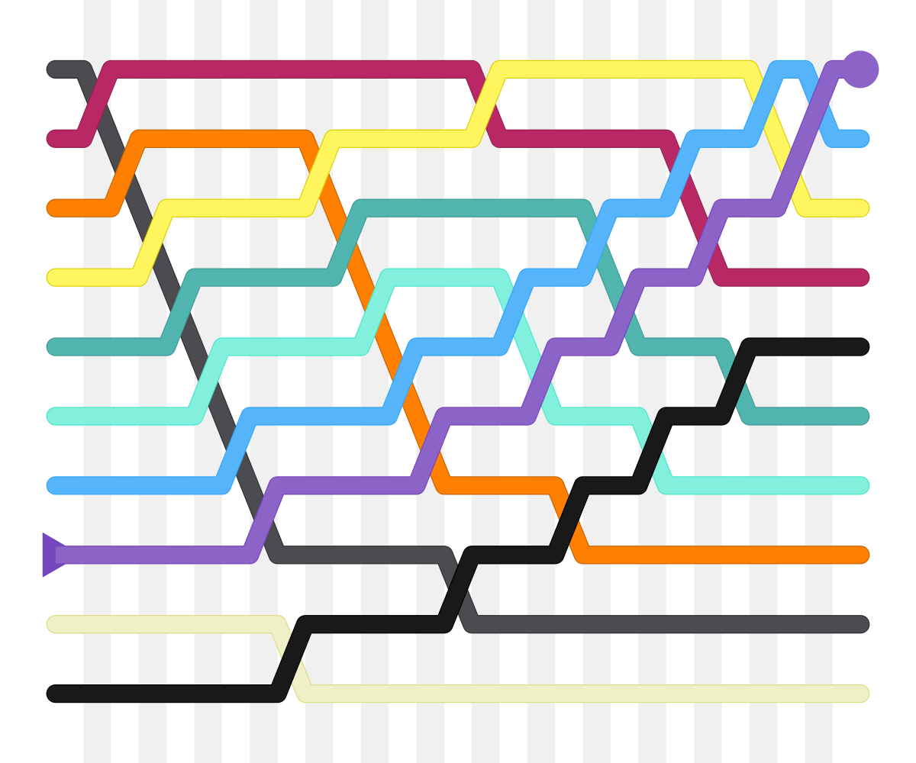
Initialization callbacks precedence
@PostConstruct
InitializingBean
initMethod in @Bean

Slide 114
Destruction callbacks
DisposableBean
destroyMethod in @Bean
@Predestroy

Slide 115
@Predestroy
@Component
public class VideoPlayer {
private AsmiqAcademyStream asmiqAcademyStream;
private YoutubeStream youtubeStream;
private String youtubeApiKey = "y7k8nd9d92dl2m";
private String asmiqAcademyApiKey = "y7k8nd9d92dl2m";
@PreDestroy
private void signOffStreams() {
asmiqAcademyStream.signOff();
youtubeStream.signOff();
}
public void run() {
// start any of the stream
}
}

Slide 116
DisposableBean
@Component
public class VideoPlayer implements DisposableBean{
private AsmiqAcademyStream asmiqAcademyStream;
private YoutubeStream youtubeStream;
private String youtubeApiKey = "y7k8nd9d92dl2m";
private String asmiqAcademyApiKey = "y7k8nd9d92dl2m";
@Override
public void destroy(){
signOffStreams ();
}
private void signOffStreams() {
asmiqAcademyStream.signOff();
youtubeStream.signOff();
}
}

Slide 117
destroyMethod in @Bean
@Component
public class VideoPlayer {
private AsmiqAcademyStream asmiqAcademyStream;
private YoutubeStream youtubeStream;
private String youtubeApiKey = "y7k8nd9d92dl2m";
private String asmiqAcademyApiKey = "y7k8nd9d92dl2m";
private void signOffStreams() {
asmiqAcademyStream.signOff();
youtubeStream.signOff();
}
public void run() {
// start any of the stream
}
}
@Configuration
public class AppConfig {
@Bean(destroyMethod="signOffStreams")
public VideoPlayer videoPlayer() {
return new VideoPlayer();
}
}

Slide 118
Destruction callbacks precedence
@PreDestroy
DisposableBean
destroyMethod in @Bean

Slide 119
Exercises – Spring Framework II Questions 9 to 10
Notes:
8 zusammen als Demo

Slide 120
Spring Framework III

Slide 121

Web-MVC
"Dieses Foto" von Unbekannter Autor ist lizenziert gemäß CC BY-NC

Slide 122
Refresh …
Servlet
Java program that runs on server.
Servlet container
A software that provides runtime for the servlets. (eg) Tomcat, Jetty

Slide 123
Servlet – An example
@Override
protected void doGet(HttpServletRequest request, HttpServletResponse response) throws ServletException, IOException {
response.setContentType("text/html");
request.authenticate(response);
PrintWriter writer = response.getWriter();
writer.println("<html>");
writer.println("<head>");
writer.println("this is simple serlvet example");
writer.println("</head>");
writer.println("<body>");
writer.println("Hello HBT :-)");
writer.println("</body>");
writer.println("</html>");
}

Slide 124
Servlet – An example
@Override
protected void doGet(HttpServletRequest request, HttpServletResponse response) throws ServletException, IOException {
authenticate(response);
createView(response);
}

Slide 125
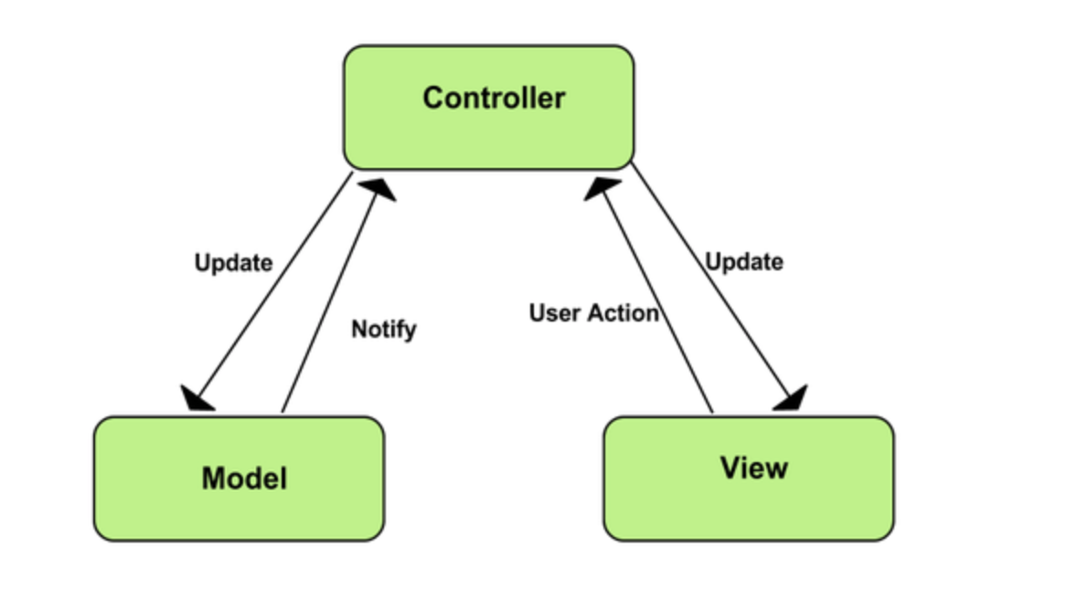
MVC
https://developer.chrome.com/apps/app_frameworks#mvc

Slide 126

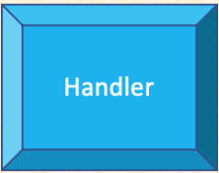
Spring Web-MVC – FrontController Pattern
Dispatcher-
Servlet
ViewResolver

Slide 127
Handler
Controller
RequestMapping / Handler
Methods

Slide 128
Controller
@Controller
@RestController

Slide 129
@Controller
@Target({ElementType.TYPE})
@Retention(RetentionPolicy.RUNTIME)
@Documented
@Component
public @interface Controller {
/**
* The value may indicate a suggestion for a logical component name,
* to be turned into a Spring bean in case of an autodetected component.
* @return the suggested component name, if any (or empty String otherwise)
*/
@AliasFor(annotation = Component.class)
String value() default "";
}

Slide 130
@Controller
public enum RequestMethod {
GET, HEAD, POST, PUT, DELETE, ...
}
@Controller
public class ShoppingBasket{
<<Request mapping method>>
}
@RequestMapping(name="/items”, method=RequestMethod.GET)
public String items(){
//return the view name for the shopping lists
}

Slide 131
@Controller
@RestController
@Controller
public class ShoppingBasket{
}
@RestController
@RequestMapping(name="/items”, method=RequestMethod.GET)
@ResponseBody
public List<ShoppingItem> items(){
//return the shopping lists
}

Slide 132
@RestController
@Target(ElementType.TYPE)
@Retention(RetentionPolicy.RUNTIME)
@Documented
@Controller
@ResponseBody
public @interface RestController {
/**
* The value may indicate a suggestion for a logical component name,
* to be turned into a Spring bean in case of an autodetected component.
* @return the suggested component name, if any (or empty String otherwise)
* @since 4.0.1
*/
@AliasFor(annotation = Controller.class)
String value() default "";
}

Slide 133
@RestController
@RestController
public class ShoppingBasket{
@GetMapping(“/items“)
}
@RequestMapping(name="/items”, method=RequestMethod.GET)
public List<ShoppingItem> items(){
//return the shopping lists
}

Slide 134

Shortcut Handler Methods
@RequestMapping(… , method=RequestMethod.GET) | @GetMapping(..).
@RequestMapping(… , method=RequestMethod.POST) | @PostMapping(…).
@RequestMapping(… , method=RequestMethod.PUT) | @PutMapping(…).
@RequestMapping(… , method=RequestMethod.DELETE) | @DeleteMapping(…)
@RequestMapping is both class level as well as method level annotation
@GetXXX,@PutXX etc are method level annotations

Slide 135
Elements of @XXXMapping
consumes
produces
method
params
headers
to narrow down the request mappings
Notes:
to narrow down the request mapping

Slide 136
produces => accept header
@GetMapping("/items")
public List<ShoppingItem> items(){
return items;
}
curl http://localhost:8080/items
curl -H "accept: application/json" http://localhost:8080/items
@GetMapping(value="/items", produces=MediaType.APPLICATION_JSON_VALUE)
public List<ShoppingItem> itemsInJSON(){
return items;
}

Slide 137
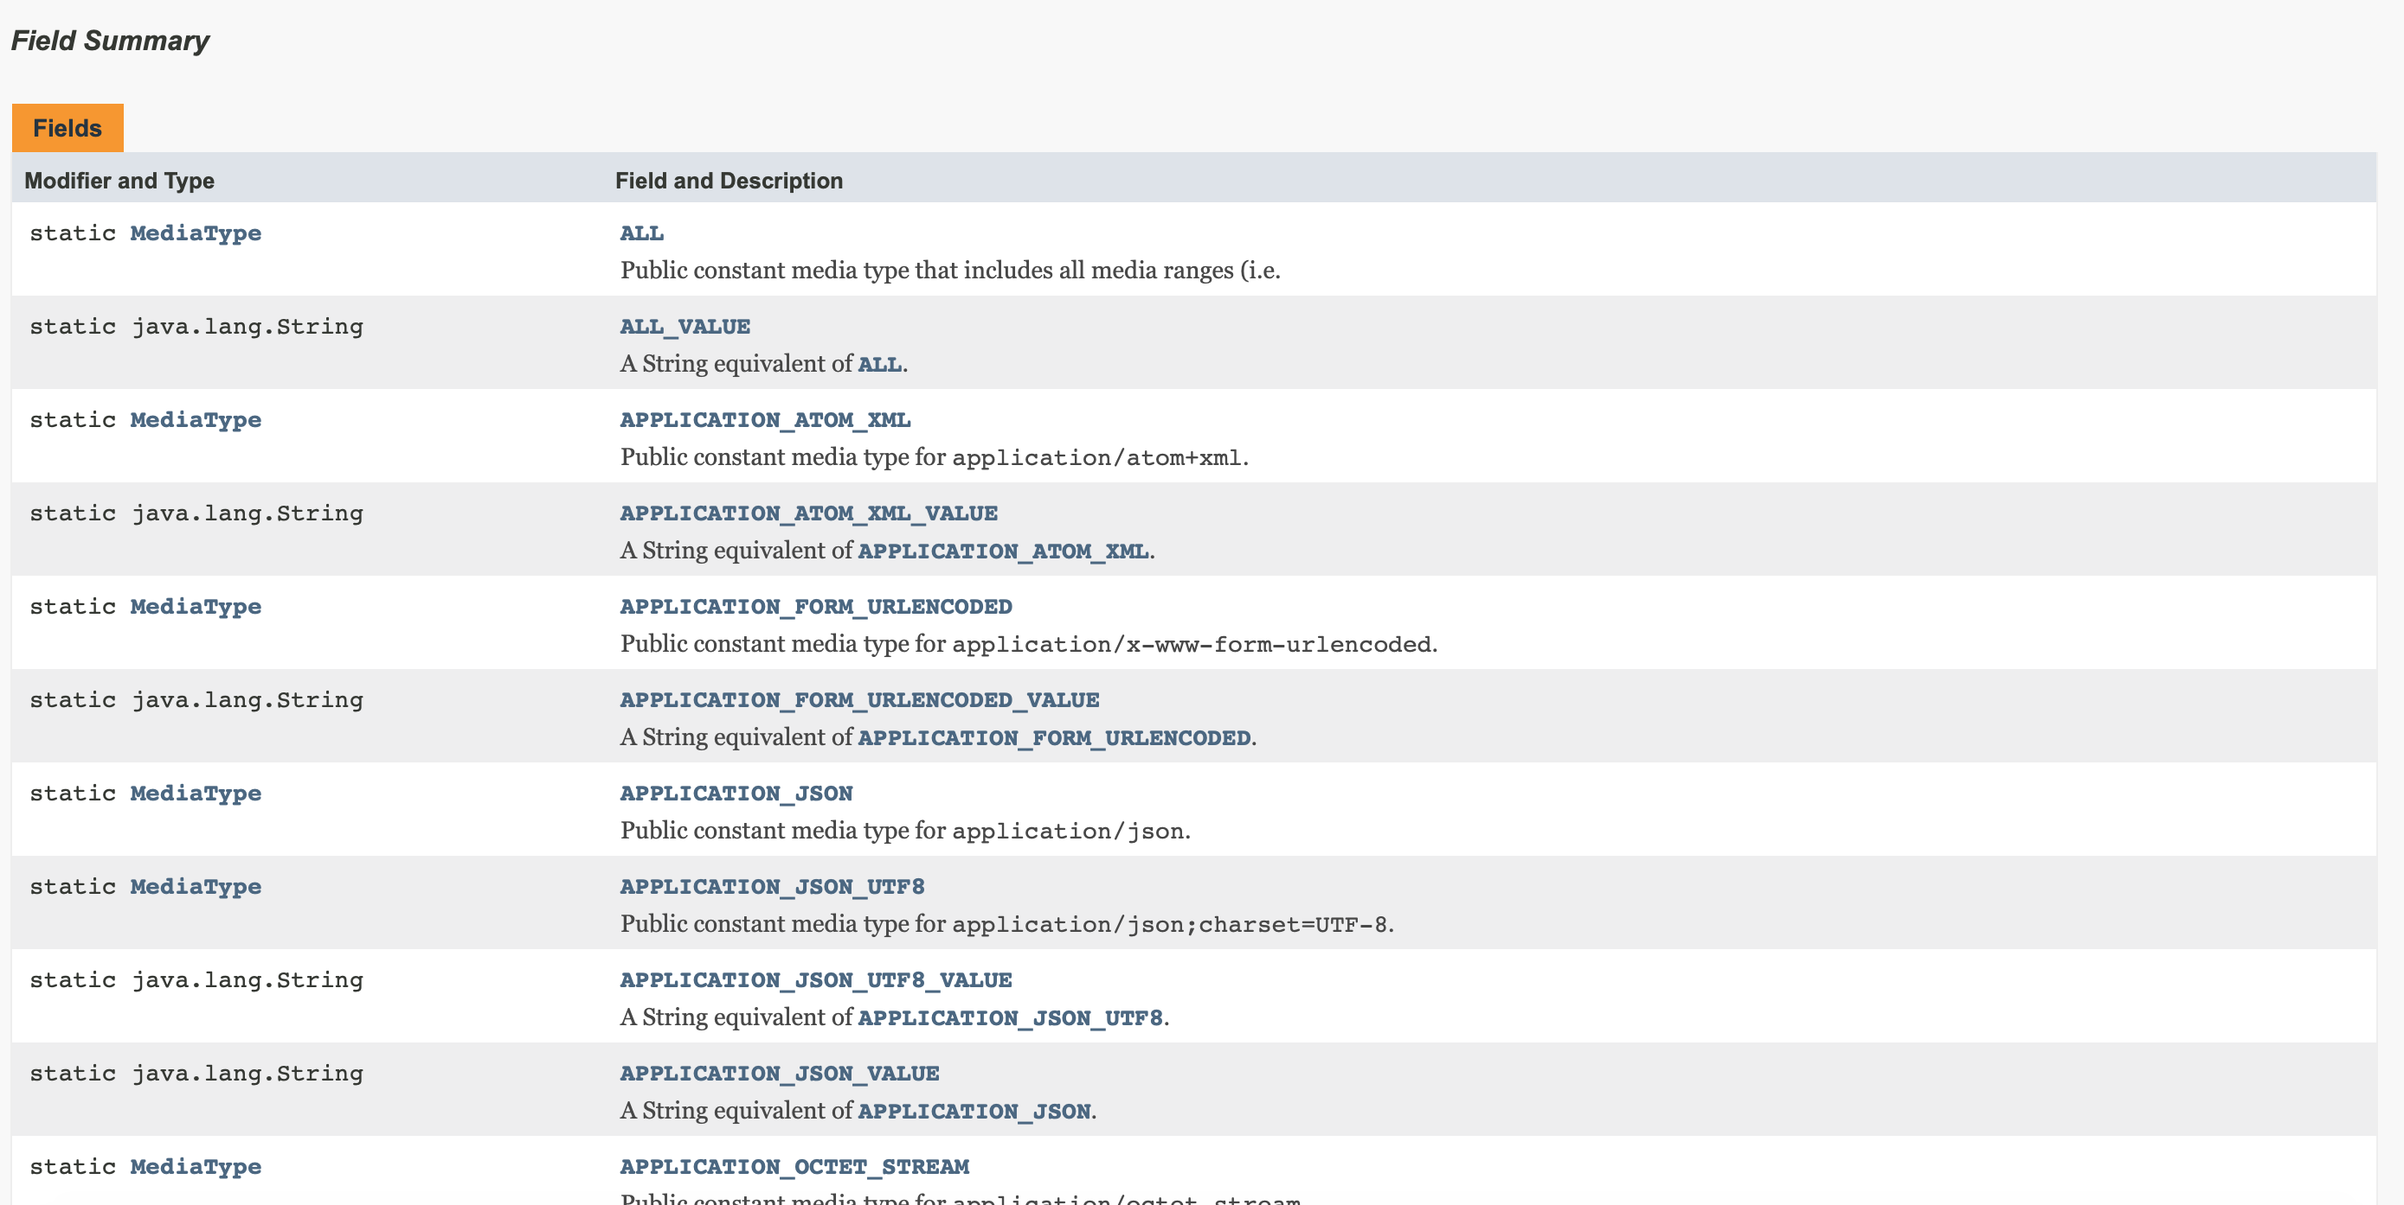
MediaType
XML
JSON

Slide 138
consumes => content-type header
@PutMapping(value="/items", consumes= {MediaType.APPLICATION_JSON_VALUE})
public List<ShoppingItem> updateItem(@RequestBody ShoppingItem item){
//update Item
}
curl -H "Content-Type: application/json" -X PUT –d {"id":1, "price":32} http://localhost:8080/items

Slide 139
headers
@GetMapping(value="/items", headers="quantity=3")
public List<ShoppingItem> itemsWithHeaderFiltered(){
//return items
}
curl -H "quantity=3" http://localhost:8080/items

Slide 140
params
@GetMapping(value="/items", params="quantity=2")
public List<ShoppingItem> itemsWithParamterFiltered(){
//return items
}
curl http://localhost:8080/items?quantity=2

Slide 141
Get a particular item
@GetMapping("/items/1")
public ShoppingItem item1(){
//return first item
}
https://localhost:8080/items/1
@GetMapping("/items/{itemId}")
public ShoppingItem getItemById(@PathVariable String itemId){
//return item with itemId
}
@GetMapping("/items/2")
public ShoppingItem item2(){
//return second item
}
https://localhost:8080/items/2
@GetMapping("/items/3")
public ShoppingItem item3(){
//return third item
}
https://localhost:8080/items/3

Slide 142
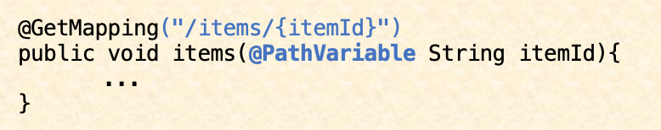
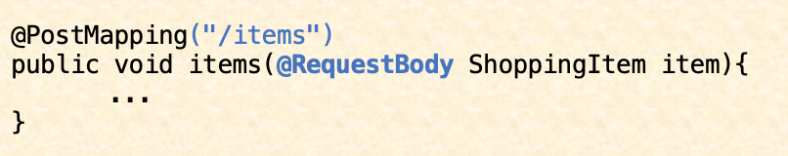
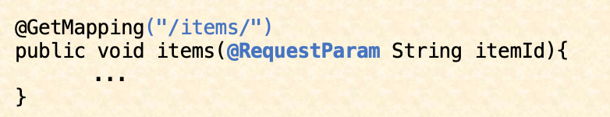
Handler Method Arguments
http://host:port/items/1
@PathVariable
@RequestBody
@RequestParam
HttpSession
…
http://host:port/items?itemId=1
Notes:
Simply put, we can use @RequestParam to extract query parameters, form parameters and even files from the request.
@GetMapping("/api/foos")
@ResponseBody
public String getFoos(@RequestParam String id) {
return "ID: " + id;
}
http://localhost:8080/api/foos?id=abc
https://www.baeldung.com/spring-request-param

Slide 143
Type Conversion (1)
Integer
Long
String
http://host:port/items/1
Short
byte
…

Slide 144
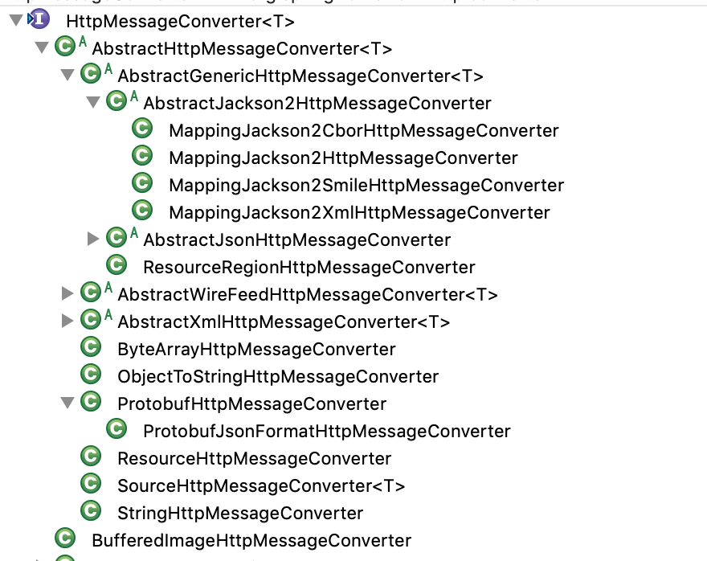
Type Conversion (2)
@PostMapping("/items")
public ShoppingItem createItem(@RequestBody ShoppingItem item){
//create the item
}
curl -H "Content-Type: application/json" -X POST –d {"id":1, "price":3} http://localhost:8080/items
@Configuration
@EnableWebMvc
@ComponentScan("ch.karthi")
public class WebAppConfig {
@Bean
public MappingJackson2HttpMessageConverter jsonMessageConverter() {
return new MappingJackson2HttpMessageConverter();
}
}
<<Interface>>
HttpMessageConverter

Slide 145
Example
@SpringJUnitConfig(classes = { App.class })
public class AppTest {
@Autowired
Service service;
@Test
public void service_test_success(){
//assert
}
}

Slide 146
Exercises – Spring Framework III Questions 12 to 15

Slide 147
Spring Boot I

Slide 148

Major Spring Projects
Notes:
Change the Picture sizes
framework, boot, data, batch, cloud, cloud data flow, integration, security.

Slide 149

Spring Boot

Slide 150

WebApp in Spring Framework (The hard way)
public class WebInitializer implements WebApplicationInitializer {
@Override
public void onStartup(ServletContext servletContext) {
//configure dispatcher servlet
}
}
public static void startTomcat() {
final var tomcat = new Tomcat();
final var connector = new Connector();
//configure tomcat
}
@Configuration
@EnableWebMvc
@ComponentScan("ch.karthi")
public class WebAppConfig {
@Bean
public MappingJackson2HttpMessageConverter jsonMessageConverter() {
return new MappingJackson2HttpMessageConverter();
}
}

Slide 151
WebApp in SpringBoot
@SpringBootApplication
public class App {
public static void main(String[] args) {
SpringApplication.run(App.class, args);
}
}

Slide 152
Spring Boot
Convention over configuration
RAD (Rapid Application Development)
Microservice
Notes:
Convention over configuration - Opinionated

Slide 153

Convention over Configuration – Project Structure
@ComponentScan("ch.karthi")
public class App {...}
└── hbt
├── HbtApplication.java
├── configs
│ └── HbtConfig.java
├── controllers
│ └── HbtController.java
└── services
└── HbtService.java
@SpringBootApplication

Slide 154



Convention over Configuration – Autoconfiguration
Scans the classpath for dependencies and configures automatically

Slide 155
RAD – Rapid Application Development
@SpringBootApplication
public class App {
public static void main(String[] args) {
SpringApplication.run(App.class, args);
}
}
@RestController
public class HBTController{
@GetMapping("/hello")
public String hello(){
return "hello hbt";
}
}
RestService to say “hello“

Slide 156
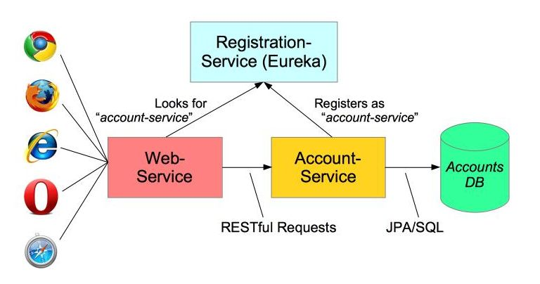
Microservice
https://spring.io/blog/2015/07/14/microservices-with-spring

Slide 157
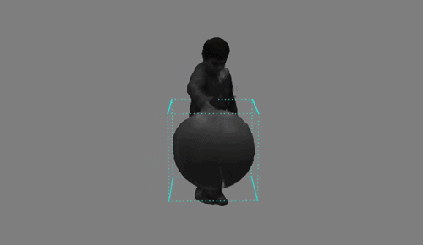
Quick Demo Spring Initializr

Slide 158
Spring Boot - JDK Baseline
Version | JDK 6 | JDK 7 | JDK 8 | JDK 9 | JDK 10 | JDK 11 | JDK 12
1.5.x
2.1.X
2.2.x
Notes:
JDK6 and JDK7 - Grey
JDK 8 LTS , JDK 11 LTS - Blue colour

Slide 159
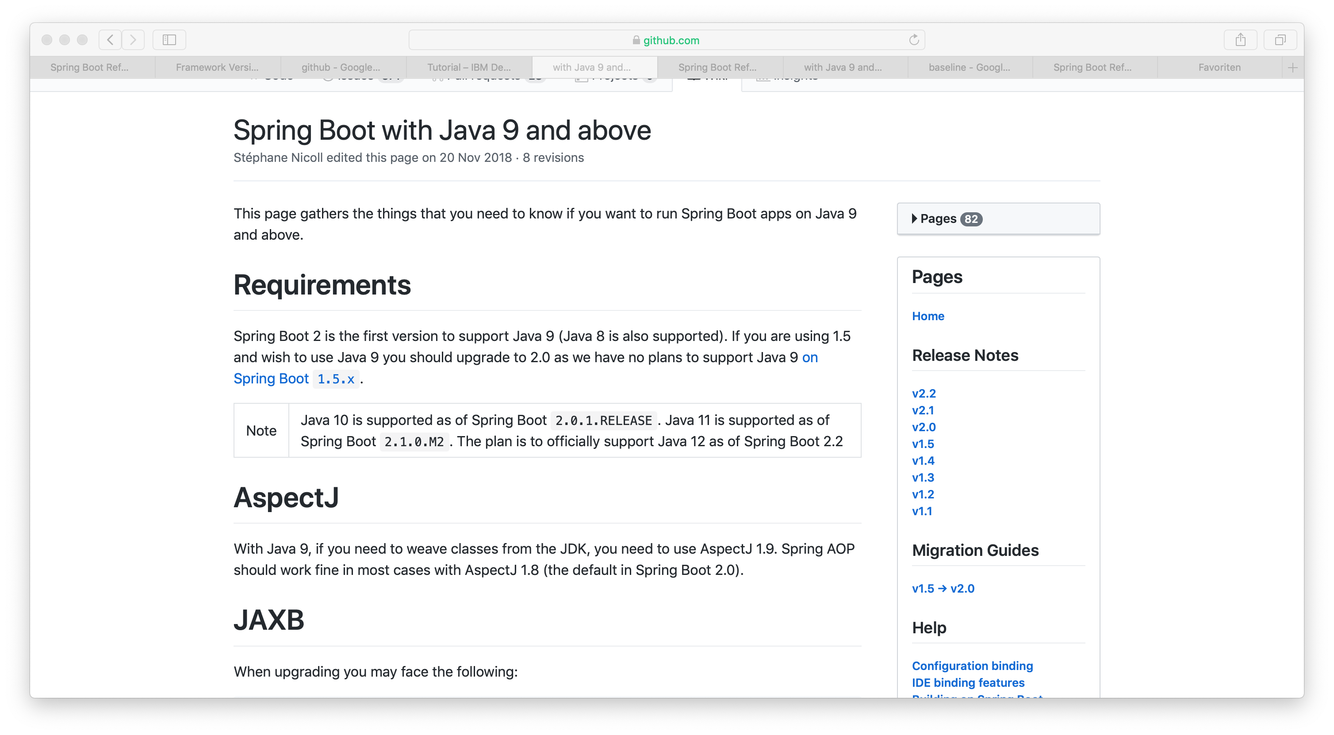
Spring Boot with JDK 9 and above

Slide 160
Installation (1)
<parent>
<groupId>org.springframework.boot</groupId>
<artifactId>spring-boot-starter-parent</artifactId>
<version>2.1.3.RELEASE</version>
<relativePath/>
</parent>
<properties>
<spring-integration.version>5.1.3.RELEASE</spring-integration.version>
<flyway.version>5.2.4</flyway.version>
</properties>

Slide 161
Installation (2)
<dependencyManagement>
<dependencies>
<dependency>
<groupId>org.springframework.boot</groupId>
<artifactId>spring-boot-starter-parent</artifactId>
<version>2.1.3.RELEASE</version>
<type>pom</type>
<scope>import</scope>
</dependency>
</dependencies>
</dependencyManagement>

Slide 162
Installation (2a)
<dependencyManagement>
<dependencies>
<dependency>
<groupId>org.flyway.db</groupId>
<artifactId>flyway-core</artifactId>
<version>5.2.4</version>
</dependency>
<dependency>
<groupId>org.springframework.boot</groupId>
<artifactId>spring-boot-starter-parent</artifactId>
…

Slide 163

Running Spring Boot Application
IDE
Run as normal Java Application
If STS installed, then Run as Spring Boot App
Maven
mvn spring-boot:run
Executable jar
java –jar <App>.jar

Slide 164
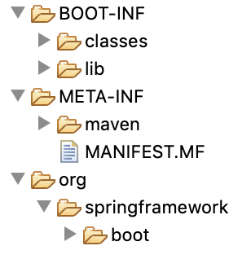
Executable Jar
Self-Contained jar
Dependencies
Resources
properties etc.
for docker containers
for PaaS (Platform as a Service)
java –jar <app>.jar

Slide 165

Starters

Slide 166

Dependencies needed for a webapp
web-mvc
jackson
jackson-databind
jackson-datatype-jdk8
jackson-datatype-jsr310
tomcat
tomcat-embedded-core
tomcat-embedded-el
…
logging
logback-classic
…
context
beans
...
...
...
version?

Slide 167
spring-boot -starter-web
<dependencies>
<dependency>
<groupId>org.springframework.boot</groupId>
<artifactId>spring-boot-starter-web</artifactId>
</dependency>

Slide 168
spring-boot-starter-web
\- org.springframework.boot:spring-boot-starter-web:jar:2.1.3.RELEASE:compile
+- org.springframework.boot:spring-boot-starter:jar:2.1.3.RELEASE:compile
| +- org.springframework.boot:spring-boot:jar:2.1.3.RELEASE:compile
| +- org.springframework.boot:spring-boot-autoconfigure:jar:2.1.3.RELEASE:compile
| +- org.springframework.boot:spring-boot-starter-logging:jar:2.1.3.RELEASE:compile
| | +- ch.qos.logback:logback-classic:jar:1.2.3:compile
| | | +- ch.qos.logback:logback-core:jar:1.2.3:compile
| | | \- org.slf4j:slf4j-api:jar:1.7.25:compile
| | +- org.apache.logging.log4j:log4j-to-slf4j:jar:2.11.2:compile
| | | \- org.apache.logging.log4j:log4j-api:jar:2.11.2:compile
| | \- org.slf4j:jul-to-slf4j:jar:1.7.25:compile
| +- javax.annotation:javax.annotation-api:jar:1.3.2:compile
| +- org.springframework:spring-core:jar:5.1.5.RELEASE:compile
| | \- org.springframework:spring-jcl:jar:5.1.5.RELEASE:compile
| \- org.yaml:snakeyaml:jar:1.23:runtime
+- org.springframework.boot:spring-boot-starter-json:jar:2.1.3.RELEASE:compile
| +- com.fasterxml.jackson.core:jackson-databind:jar:2.9.8:compile
| | +- com.fasterxml.jackson.core:jackson-annotations:jar:2.9.0:compile
| | \- com.fasterxml.jackson.core:jackson-core:jar:2.9.8:compile
| +- com.fasterxml.jackson.datatype:jackson-datatype-jdk8:jar:2.9.8:compile
| +- com.fasterxml.jackson.datatype:jackson-datatype-jsr310:jar:2.9.8:compile
| \- com.fasterxml.jackson.module:jackson-module-parameter-names:jar:2.9.8:compile
+- org.springframework.boot:spring-boot-starter-tomcat:jar:2.1.3.RELEASE:compile
| +- org.apache.tomcat.embed:tomcat-embed-core:jar:9.0.16:compile
| +- org.apache.tomcat.embed:tomcat-embed-el:jar:9.0.16:compile
| \- org.apache.tomcat.embed:tomcat-embed-websocket:jar:9.0.16:compile
+- org.hibernate.validator:hibernate-validator:jar:6.0.14.Final:compile
| +- javax.validation:validation-api:jar:2.0.1.Final:compile
| +- org.jboss.logging:jboss-logging:jar:3.3.2.Final:compile
| \- com.fasterxml:classmate:jar:1.4.0:compile
+- org.springframework:spring-web:jar:5.1.5.RELEASE:compile
| \- org.springframework:spring-beans:jar:5.1.5.RELEASE:compile
\- org.springframework:spring-webmvc:jar:5.1.5.RELEASE:compile
+- org.springframework:spring-aop:jar:5.1.5.RELEASE:compile
+- org.springframework:spring-context:jar:5.1.5.RELEASE:compile
\- org.springframework:spring-expression:jar:5.1.5.RELEASE:compile

Slide 169
Starters
“ one-stop shop“ for all the dependencies
Need not have to hunt for the dependencies
just add the starter dependency and start writing business code

Slide 170
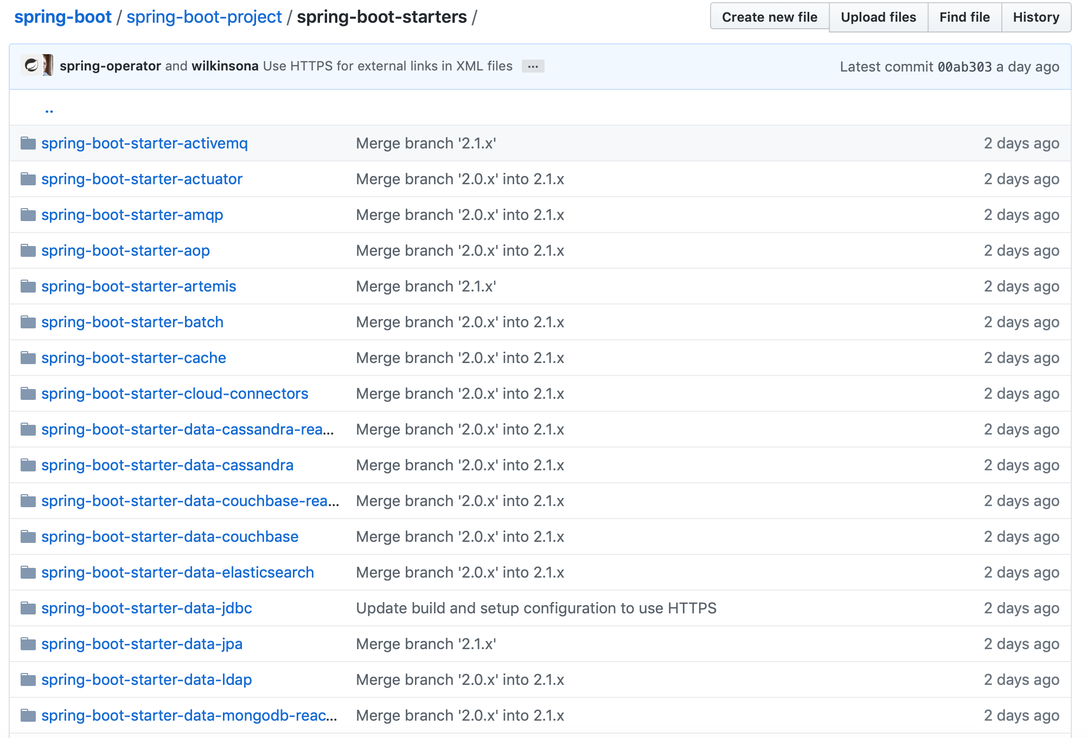
Starter Projects

Slide 171
Annotation in Details
@SpringBootApplication

Slide 172
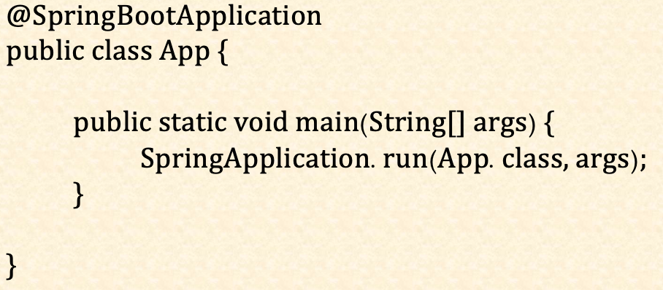
@SpringBootApplication

Slide 173
@SpringBootApplication
@SpringBootConfiguration
@Configuration
@EnableAutoConfiguration
@ComponentScan

Slide 174

@EnableAutoConfiguration
Configures beans automatically
Conventions
> 100 Autoconfigurations available

Slide 175

@EnableAutoConfiguration

Slide 176
Non-Invasive
Excluding auto-configuration
Annotation
@SpringBootApplication(exclude= {RabbitAutoConfiguration.class})
@SpringBootApplication(excludeName= {"RabbitAutoConfiguration"})
Property
spring.autoconfigure.exclude=org.springframework.boot.autoconfigure.amqp. RabbitAutoConfiguration
@EnableAutoConfiguration

Slide 177

Developer Tools
Automatic Restart
any entry on the classpath
NOT – static resources & templates
Default Configs
Cache is disabled
Log level DEBUG für “web“
LiveReload
Triggers a browser refresh

Slide 178
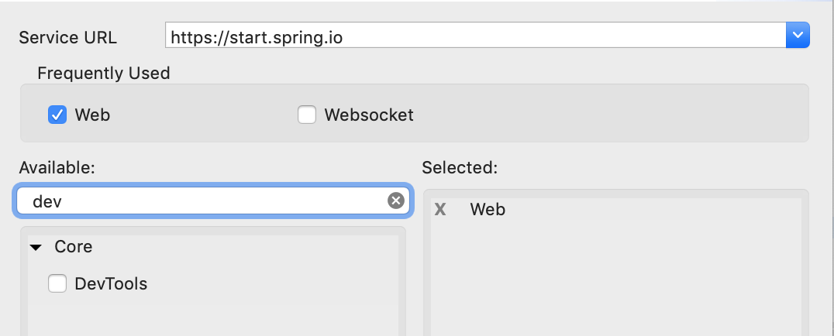
Developer Tools
Setup
<dependency>
<groupId>org.springframework.boot</groupId>
<artifactId>spring-boot-devtools</artifactId>
<scope>runtime</scope>
</dependency>
Notes:
runtime This scope indicates that the dependency is not required for compilation, but is for execution. It is in the runtime and test classpaths, but not the compile classpath.

Slide 179
Developer Tools
Excluding Resources
spring.devtools.restart.exclude
Additional Paths
spring.devtools.restart.additional-paths
Disable restart
spring.devtools.restart.enabled
Triggering restart
spring.devtools.restart.trigger-file
Configurations
Notes:
If you work with an IDE that continuously compiles changed files, you might prefer to trigger restarts only at specific times. To do so, you can use a “trigger file”, which is a special file that must be modified when you want to actually trigger a restart check. Changing the file only triggers the check and the restart only occurs if Devtools has detected it has to do something. The trigger file can be updated manually or with an IDE plugin.

Slide 180
Quick Demo Dev-Tools

Slide 181
Exercises – Spring Boot I

Slide 182

Spring Boot 2 + Spring Data

Slide 183
Developer Tools
our classes
our classes
Restart Classloader
Restart Classloader
Restart Technology
3rd Party jars
Base Classloader

Slide 184
Get a particular item
@GetMapping("/items/")
public void items(@RequestParam String itemId){
...
}
http://host:port/items/1
@GetMapping("/items/{itemId}")
public void items(@PathVariable String itemId){
...
}
@PostMapping("/items")
public void items(@RequestBody ShoppingItem item){
...
}

Slide 185
Bean Scopes
Singleton
Prototype
Request
@RequestScope
Session
@SessionScope
Application
@ApplicationScope
WebSocket
@Scope(scopeName = "websocket")
Notes:
application: Scopes a single bean definition to the lifecycle of a ServletContext. Only valid in the context of a web-aware Spring ApplicationContext.

Slide 186

Testing

Slide 187
Spring TestContext Framework
Provides the container to the tests and caches them.
Test Framework annotations:
@ContextConfguration
@DirtiesContext
@Commit
@Rollback
@SpringJunitConfig
Junit5

Slide 188





Cloud Native

Slide 189
Testing

Slide 190
Testing
\- org.springframework.boot:spring-boot-starter-test:jar
+- org.springframework.boot:spring-boot-starter:jar
| +- org.springframework.boot:spring-boot:jar
...
+- com.jayway.jsonpath:json-path:jar
...
+- junit:junit:jar
+- org.assertj:assertj-core
+- org.mockito:mockito-core
...
+- org.hamcrest:hamcrest-core:jar
+- org.hamcrest:hamcrest-library:jar
+- org.skyscreamer:jsonassert:jar
+- org.springframework:spring-core:jar
| \- org.springframework:spring-jcl:jar
+- org.springframework:spring-test:jar
..
spring-boot-starter-test

Slide 191
Testing
@SpringBootTest(webEnvironment = WebEnvironment.RANDOM_PORT)
public class AppTest {
@LocalServerPort
int port;
@Autowired
private TestRestTemplate testRestTemplate;
@Test
public void test_method(){
//assert
}
}
Example

Slide 192
@SpringBootTest
@BootstrapWith(SpringBootTestContextBootstrapper.class)
@ExtendWith(SpringExtension.class)
public @interface SpringBootTest {
….
@BootstrapWith(SpringBootTestContextBootstrapper.class)
@ExtendWith(SpringExtension.class)
public @interface SpringBootTest {
….
Internals

Slide 193

RestTemplate
.
Client for HTTP Requests
Sync
Methods for common use-cases
get
put
post
delete
less common use-cases
exchange
execute

Slide 194
RestTemplate
restTemplate.getForObject(“http://localhost:8080/items“, ShoppingItem.class, “1“);
restTemplate.put(“http://localhost:8080/items“, ShoppingItem.class, “1“);
Example
restTemplate.postForObject(“http://localhost:8080/items“, item,ShoppingItem.class,);

Slide 195

Taste of spring data

